Slide 1
Float Nirvana: A Full-Stack Sensory Deprivation Therapy Booking & Wellness Management System
CAPSTONE PROJECT
(Submitted in partial fulfillment of the Summer Internship on Full Stack Web Development, 2025)
Presented By: Kolli Chitra Bhanu
M.Tech – CSE (AIML)
AP24122040019
SRM University AP

Slide 2
OUTLINE
Problem Statement (Should not include solution)
System Architecture & Technology Stack
Database Schema & API Design
Implementation & Key Features
Deployment & Live Demonstration
Results & Code (Sample snippets)
Conclusion
Future Scope
References

Slide 3
Problem Statement
In today’s fast-paced and stressful world, many individuals suffer from anxiety, mental fatigue, and reduced well-being, impacting their quality of life.
Traditional wellness practices often require significant time, commitment, and financial resources, making them inaccessible for many people.
Although sensory deprivation therapy (float therapy) provides quick and evidence-based benefits such as stress relief, improved sleep, and mental clarity, access to these services is currently fragmented and difficult to navigate.
Additionally, float therapy providers face challenges in efficiently managing bookings and reaching potential clients.
These barriers prevent both users and providers from maximizing the positive impact float therapy can have on mental and physical health, limiting its broader adoption and societal benefit.
Many potential users lack reliable information about local float therapy options, pricing, and session availability, which leads to confusion and reduced engagement.
The absence of a unified, digital platform restricts collaboration among wellness providers and limits opportunities to offer bundled or complementary wellness services, further hampering the industry’s growth.

Slide 4
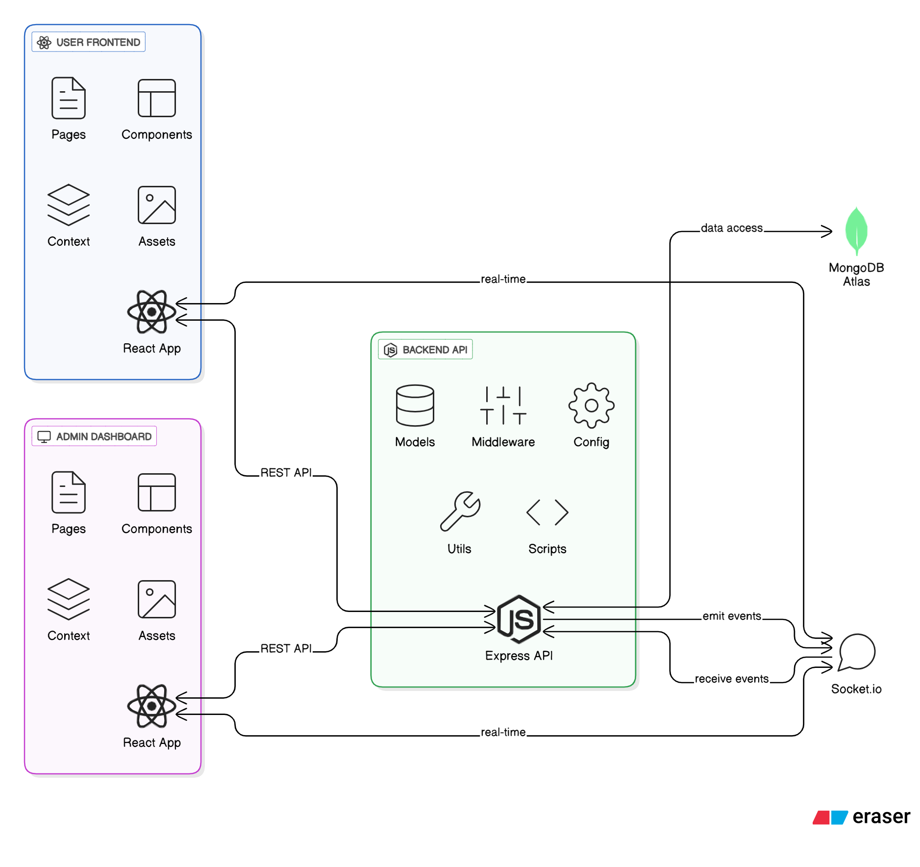
System Architecture
The diagram shows the high-level architecture of the Float Nirvana platform.
It has two frontends: User Frontend and Admin Dashboard, both built with React.
Both frontends communicate with the backend via REST API for data and operations.
The backend is built with Node.js and Express and handles all business logic.
The backend uses middleware for authentication, validation, and security.
Only the backend interacts directly with the database for secure data access.
Socket.io is used for real-time communication between the backend and frontends.
Real-time events include notifications, booking updates, and system alerts.
MongoDB Atlas is used as the database to store users, sessions, bookings, and more.
Float Nirvana - High-Level System Architecture

Slide 5
Technology Stack
1. Frontend:
Languages:
TypeScript
JavaScript (ES2020 compatible)
Framework & Libraries:
React 18 (with React JSX)
React Router (for client-side routing)
Tailwind CSS (utility-first CSS framework for styling)
Framer Motion (for animations)
Socket.io Client (for real-time communication)
Vite (build tool and development server)
2. Backend:
Languages:
TypeScript / JavaScript (Node.js environment)
Framework & Libraries:
Node.js with Express.js (web server and REST API framework)
Socket.io (WebSocket server for real-time features)
Mongoose (MongoDB ODM for data modeling and schema management)
JWT (JSON Web Tokens for authentication)
bcryptjs (for password hashing and security)

Slide 6
3. Database:
Database System:
MongoDB Atlas (cloud-hosted NoSQL document database)
4. APIs and Third-party Services:
Payments:
Not explicitly mentioned as integrated in the current documentation (payment integration is "ready," but no specific payment API like Stripe is listed)
Other APIs:
Socket.io for real-time event communication between frontend and backend
Potential integration with external services (e.g., email/sms notifications) not explicitly specified in the current docs

Slide 7
Database Schema & API Design
The project uses MongoDB Atlas, a NoSQL document database. The main collections and their fields, along with relationships, are described below.
Main Collections and Fields
Collection | Key Fields / Schema Overview | Description / Relationships
Users | _id, name, email, passwordHash, role (admin/user), profileInfo, createdAt, updatedAt | Stores user information. One-to-many with Bookings, Orders, SupportTickets, Activities
Sessions | _id, title, description, duration, price, availability, createdAt, updatedAt | Represents float therapy sessions available for booking
Bookings | _id, userId (ref Users), sessionId (ref Sessions), bookingDate, status (confirmed/pending/cancelled), createdAt | Links users with session bookings

Slide 8
Products | _id, name, description, price, inventoryCount, createdAt, updatedAt | Items for sale in the marketplace
Orders | _id, userId (ref Users), productList [{productId, quantity}], totalAmount, status, paymentInfo, createdAt | User product purchases
SupportTickets | _id, userId (ref Users), subject, description, status, messages [{sender, message, timestamp}], createdAt | Customer support tickets
Activities | _id, userId (ref Users), actionType, actionDetails, timestamp | Logs of user activities for auditing and analytics
Notifications | _id, userId (ref Users), type, message, isRead, timestamp | System notifications sent to users

Slide 9
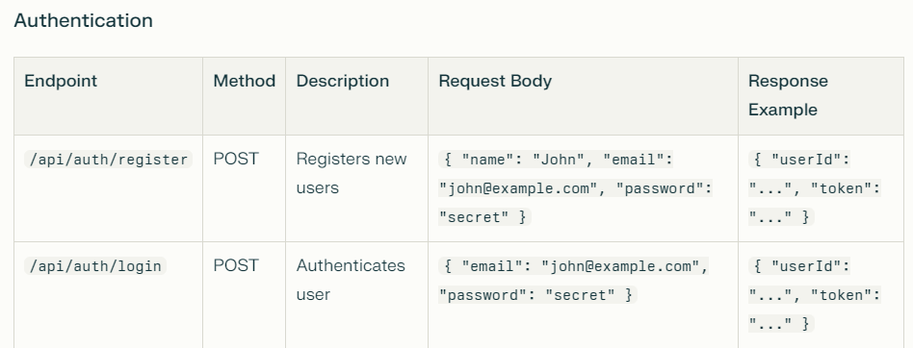
2. API Endpoints Design
The backend provides RESTful API endpoints via Express.js that the frontend consumes. Below is an organized overview of the main routes, their purpose, and example request/response structures.
Authentication

Slide 10
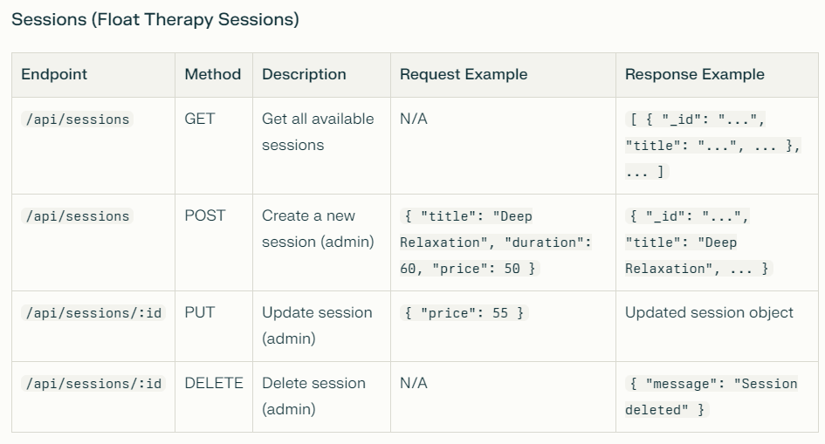

Slide 11
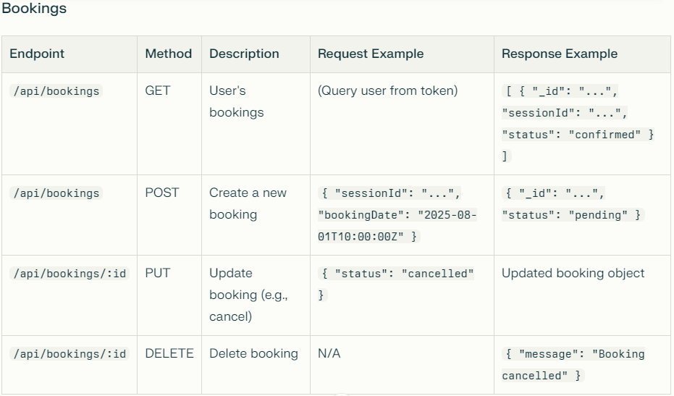

Slide 12
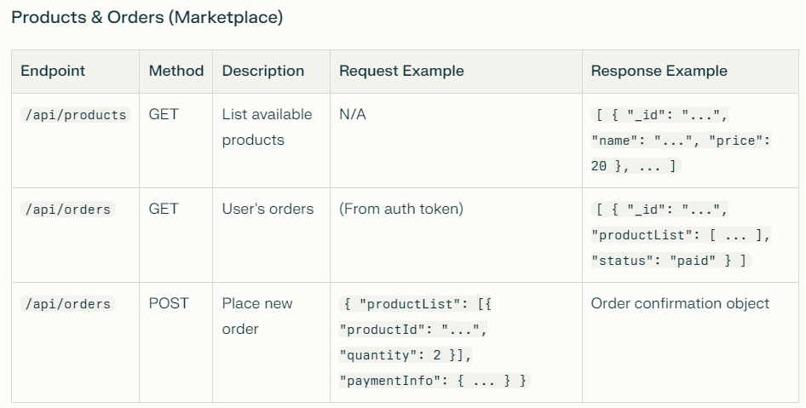

Slide 13
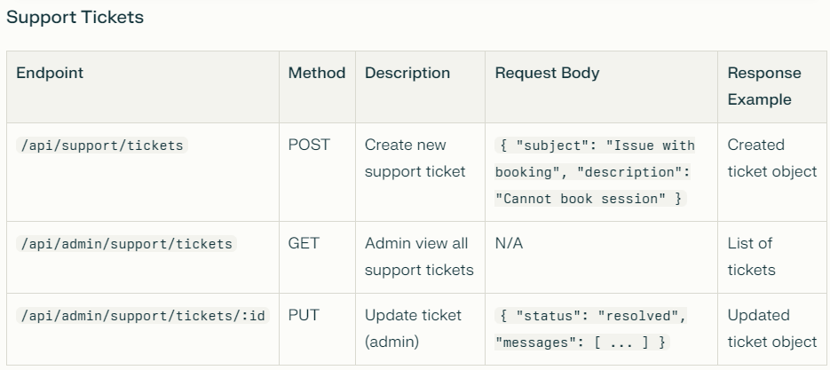
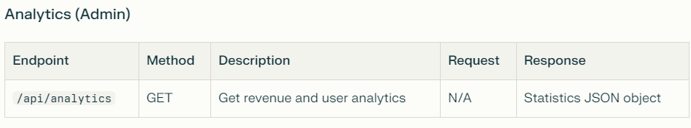

Slide 14
Example: Get All Sessions (GET /api/sessions)
Response:
[
{
"_id": "64d2bc843f1a4d2bfe8d1eee",
"title": "Relaxing Float Session",
"description": "60-minute float session to relax muscles and mind.",
"duration": 60,
"price": 50,
"availability": true
},
{
"_id": "64d2bc943f1a4d2bfe8d1eef",
"title": "Deep Meditation Float",
"description": "90-minute extended float for mental clarity.",
"duration": 90,
"price": 80,
"availability": true
}
]
Example JSON Request/Response
Example: Register New User (POST /api/auth/register)
Request Body:
{
"name": "Alice Smith",
"email": "alice@example.com",
"password": "strongpassword123"
}
Response:
{
"userId": "64d2bb4f3f1a4d2bfe8d1eec",
"token": "eyJhbGciOiJIUzI1NiIsInR5cCI..."
}

Slide 15
Implementation & Key Features
Step-by-Step Procedure
Project Setup
Initialized a mono-repo structure with separate frontend (React) and backend (Node.js/Express) folders for modular development.
Configured simultaneous development environments using scripts and tools such as Vite (for the frontend) and Nodemon (for the backend)123.
Established shared TypeScript configurations and linting rules for code quality and maintainability4567.
Frontend Development
Created the user interface using React 18 with TypeScript.
Leveraged Tailwind CSS for a modern and responsive design, ensuring accessibility across devices.
Built reusable components for session booking, user authentication/profile management, real-time notifications, and product listings (marketplace).
Implemented React Router for seamless client-side navigation between booking, profile, marketplace, and administration pages.
Used Socket.io Client for delivering instant updates such as booking confirmations and support responses.
Developed an advanced Admin Dashboard featuring analytics, user/content controls, and support management.

Slide 16
3. Backend Development
Implemented a Node.js/Express API configured for RESTful interaction.
Integrated MongoDB Atlas for data persistence, using Mongoose for schema/model definitions and robust querying.
Applied business logic for session management, booking flows, product orders, and support ticket processing.
Secured the system with JWT-based authentication and bcryptjs for password hashing.
Established admin routes for advanced management features, only accessible by authorized users.
Enabled real-time features and notifications with Socket.io (websockets).
4. Integration & Testing
Connected frontend and backend using precise environment variables and endpoint mapping3.
Implemented developer and user scripts for localized builds, tests, and production deployment1.
Designed and tested responses for multiple user roles (user, admin).

Slide 17
Key Features
User-Facing Features
Float Session Booking
Browse and schedule float therapy sessions seamlessly.
Real-time availability updates.
User Authentication & Profiles
Secure login/registration.
Manage personal information and view booking history.
Product Marketplace
Explore and purchase wellness products.
Integrated with an order management system.
Responsive, Modern UI
Designed for a smooth experience on both desktop and mobile.
Real-Time Notifications
Instant updates for booking confirmations, order status, and support communications.

Slide 18
Admin/Provider Features
Advanced Analytics Dashboard
Visualize bookings, revenue, and user engagement at a glance.
Comprehensive User Management
Access user lists, edit details, assign roles, and manage bans.
Content & System Management
Update website content, configure business settings, manage products, and sessions.
Database Management Tools
View and manage persistent records directly from the dashboard.
Support Ticket System
Manage and resolve customer issues efficiently, with message threading.
Security & Permissions
Robust role-based access control for critical actions.

Slide 19
System-Level Features
RESTful API Endpoints
Well-structured routes for authentication, sessions, bookings, orders, support, and analytics management.
Real-Time Capabilities
Instant send/receive of events between clients and server with Socket.io.
Cloud Database
Persistent, scalable storage using MongoDB Atlas for all data objects (users, sessions, bookings, orders, etc.).

Slide 20
Deployment & Live Demonstration
Deployment Platform: The Float Nirvana application was deployed using Vercel, a popular platform for hosting modern frontend and full-stack web applications. Vercel offers seamless integration with GitHub repositories, automated builds on push, and rapid global content delivery, making it ideal for React-based projects like Float Nirvana.
Deployment Process Overview:
Connected the project repository to Vercel via GitHub integration.
Configured build settings for both the frontend (React/Vite) and backend as needed (API routes or separate backend deployment if required).
Set up necessary environment variables (API base URLs, authentication secrets, etc.).
Deployed the application, allowing Vercel to build and host the static frontend and manage any configured serverless API endpoints.
Verified that all main features—including float session booking, user authentication, real-time notifications, and the admin dashboard—are accessible from the live URL.
Live Application Link: https://float-nirvana.vercel.app/

Slide 21
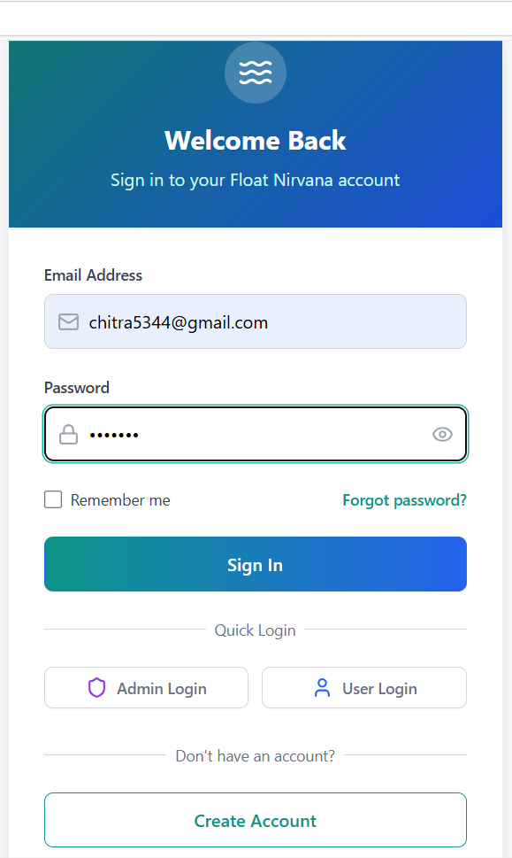
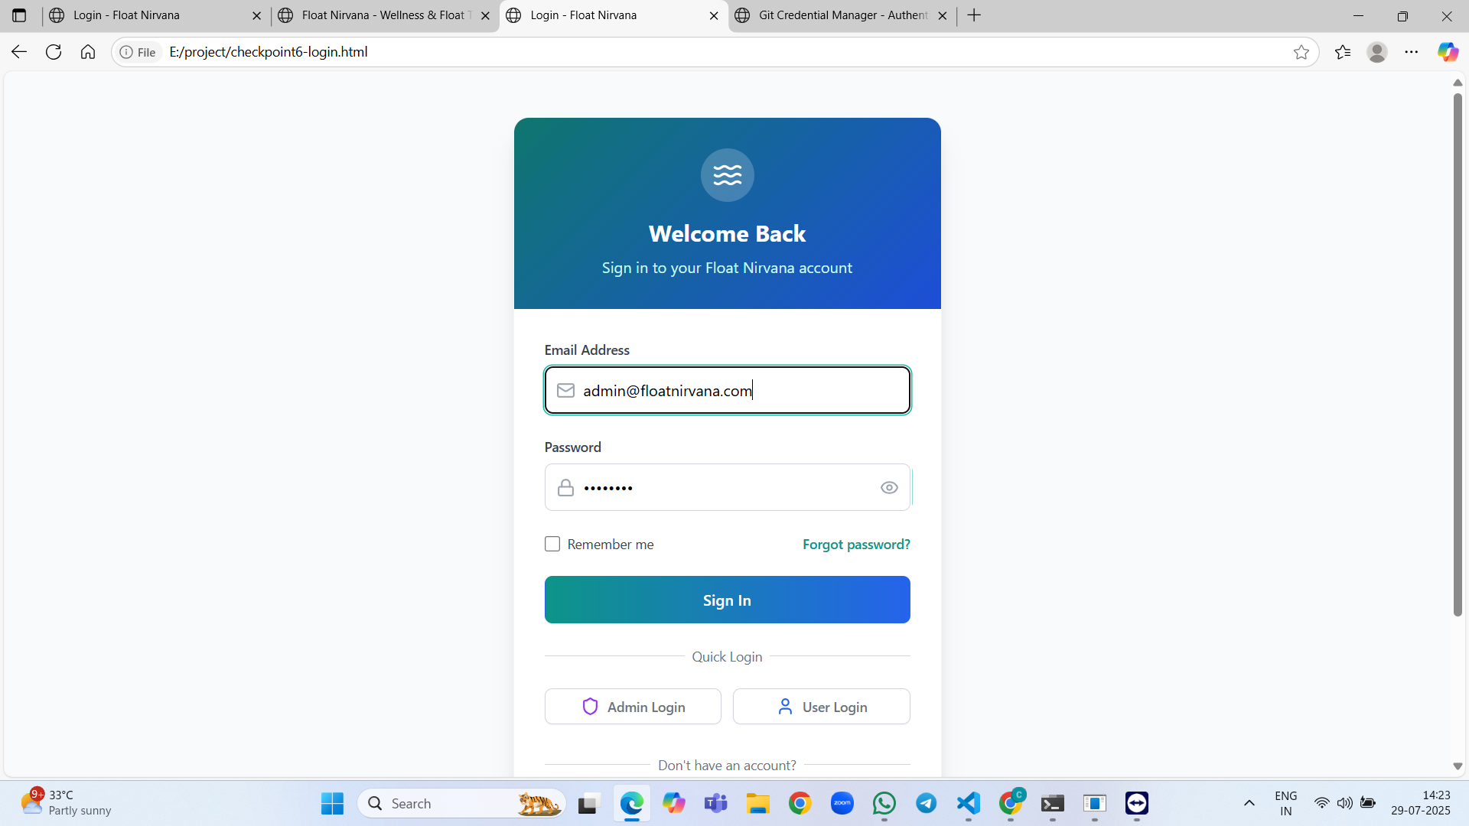
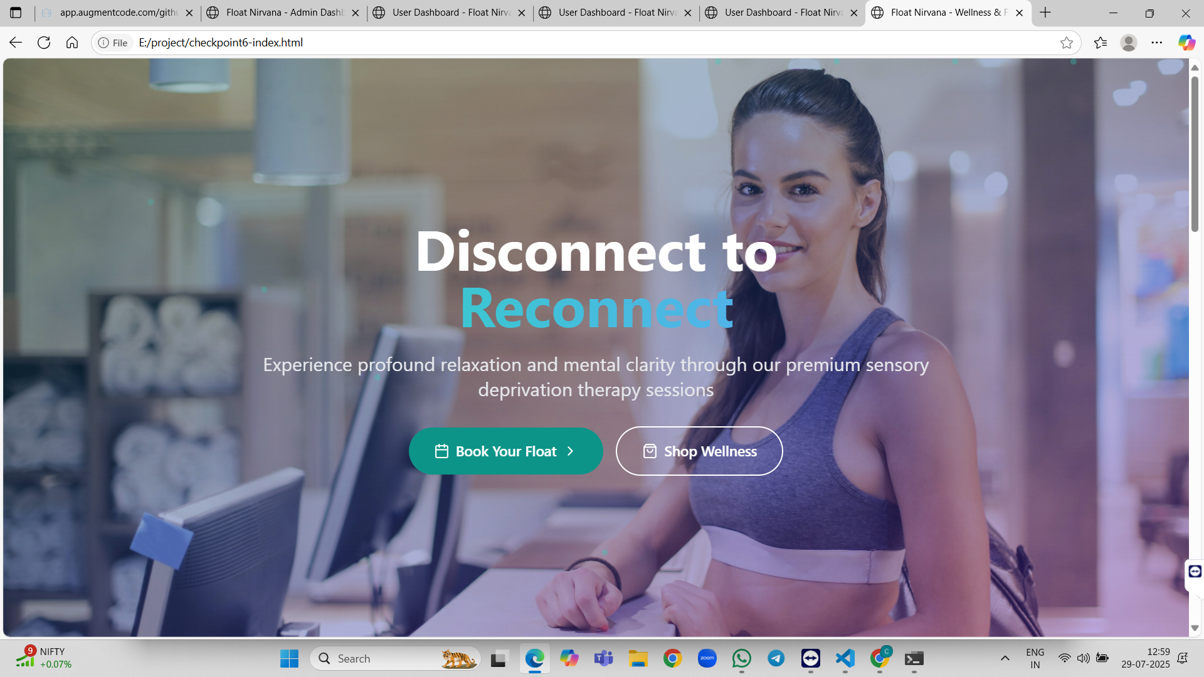
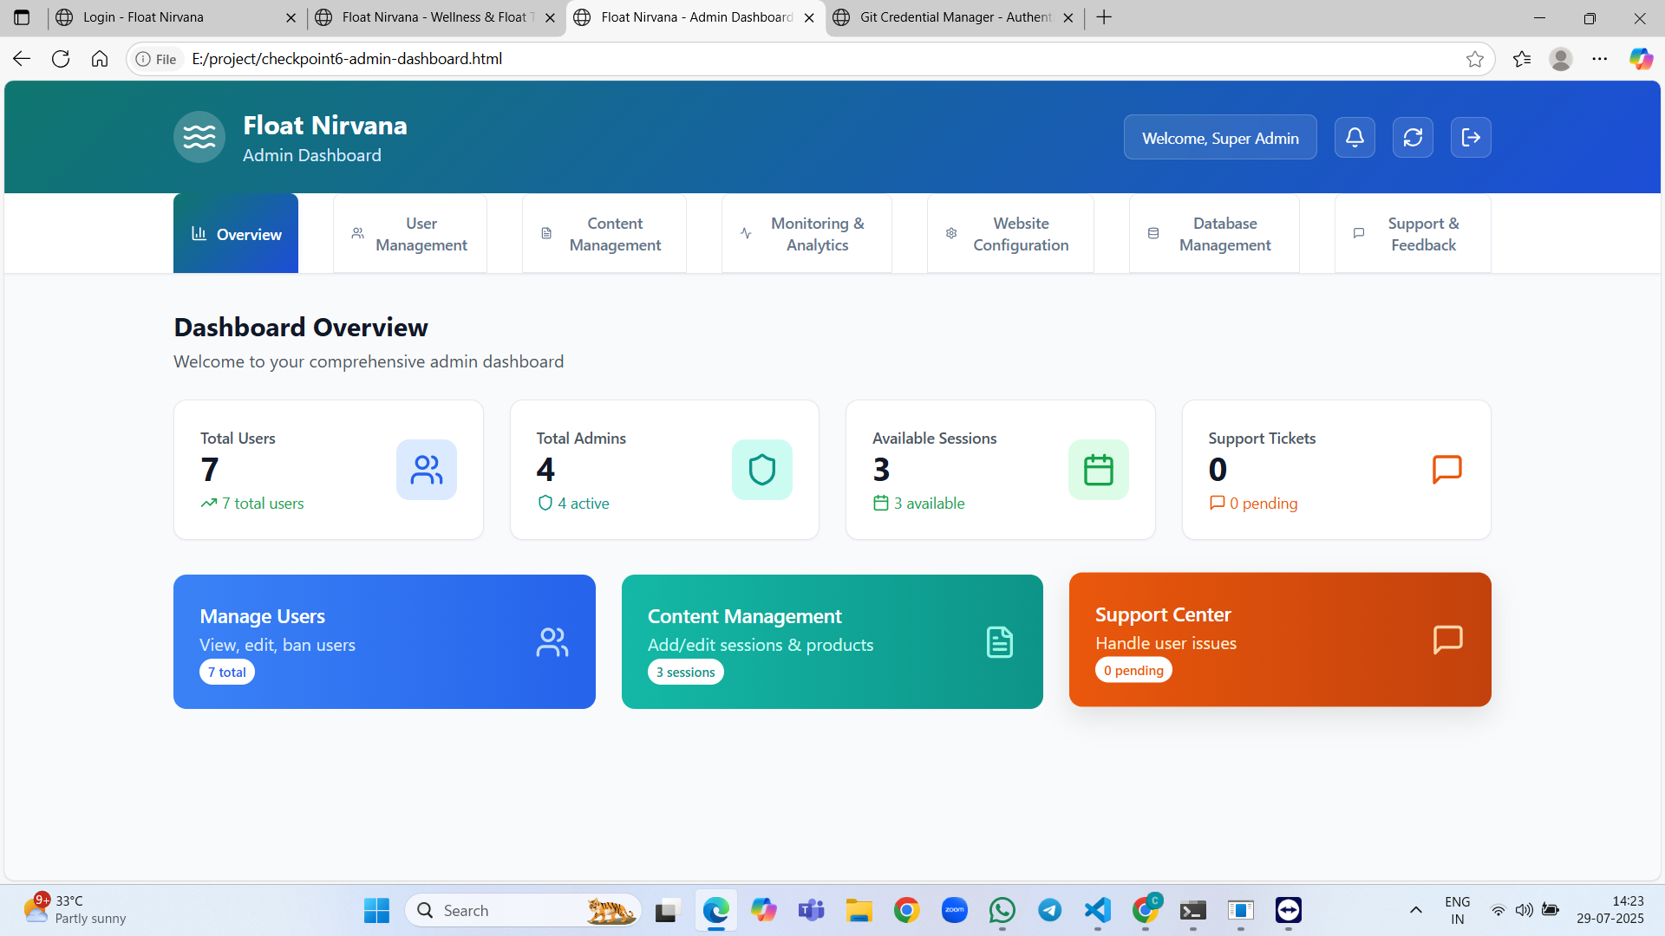
Results and code

Slide 22
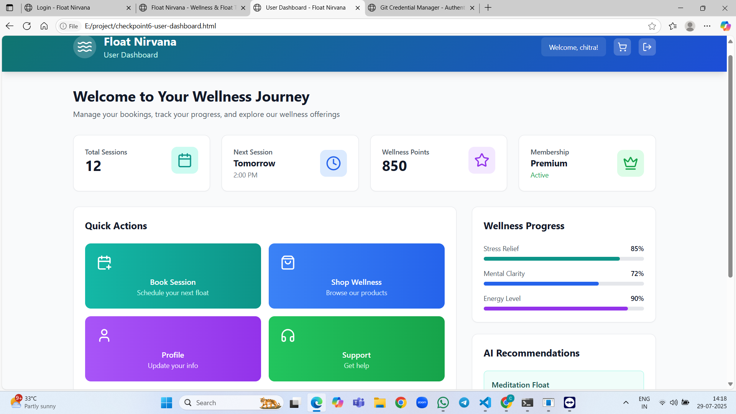
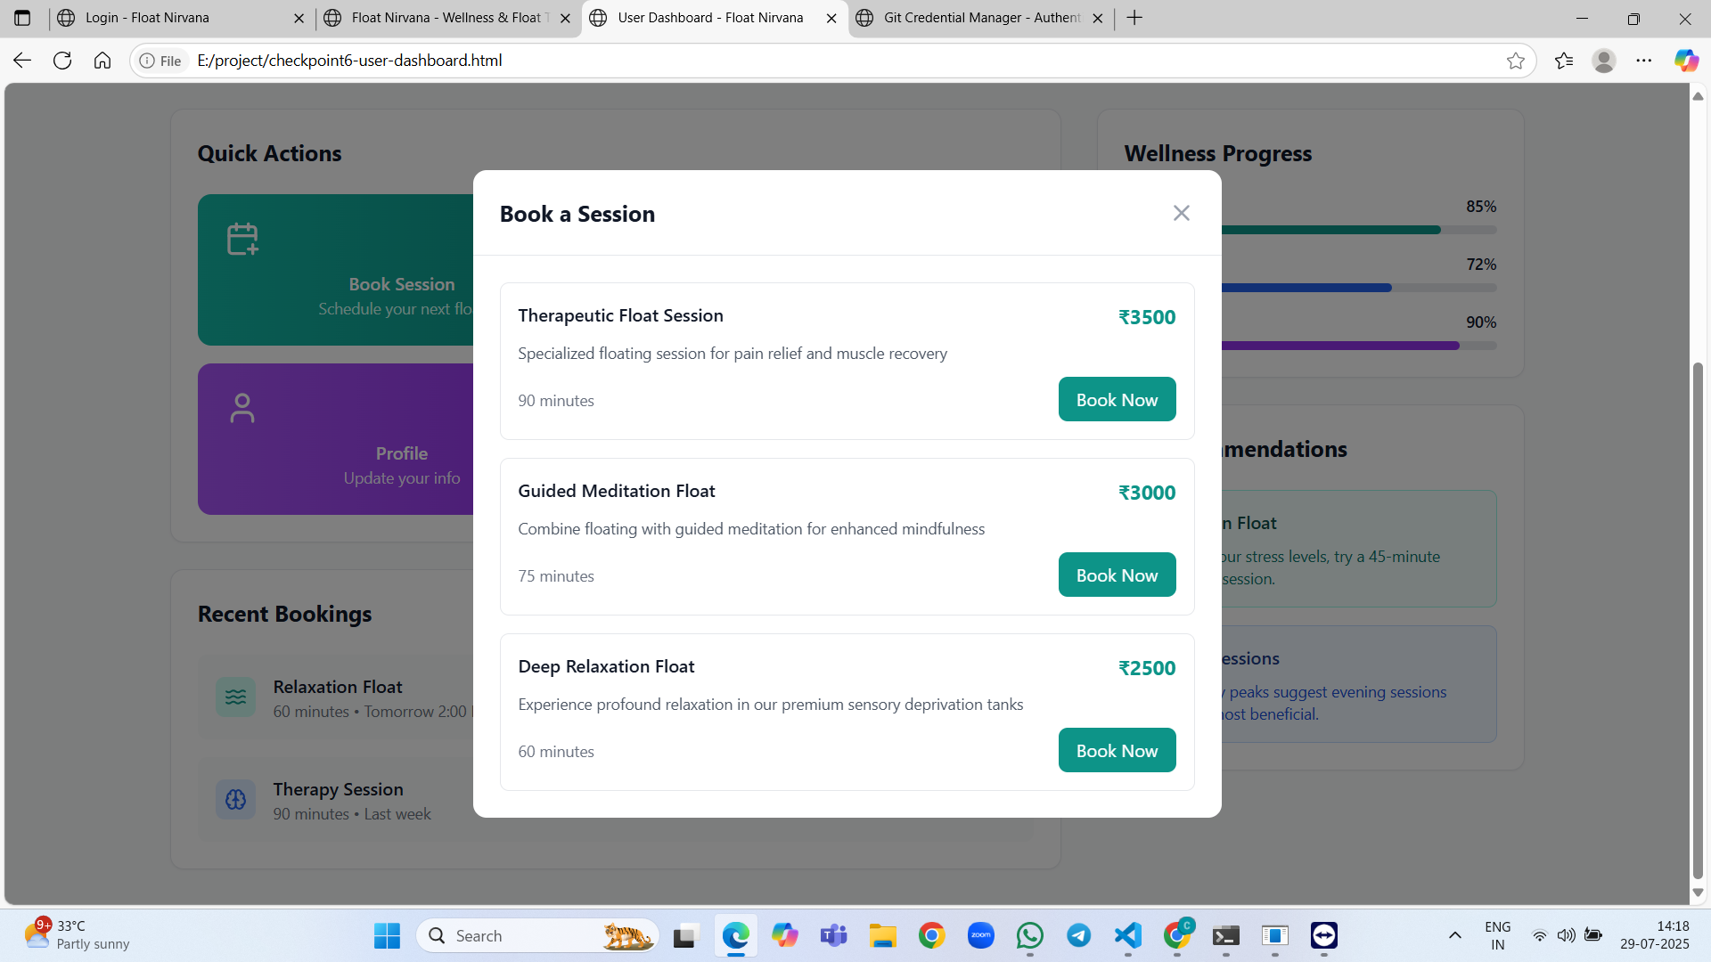
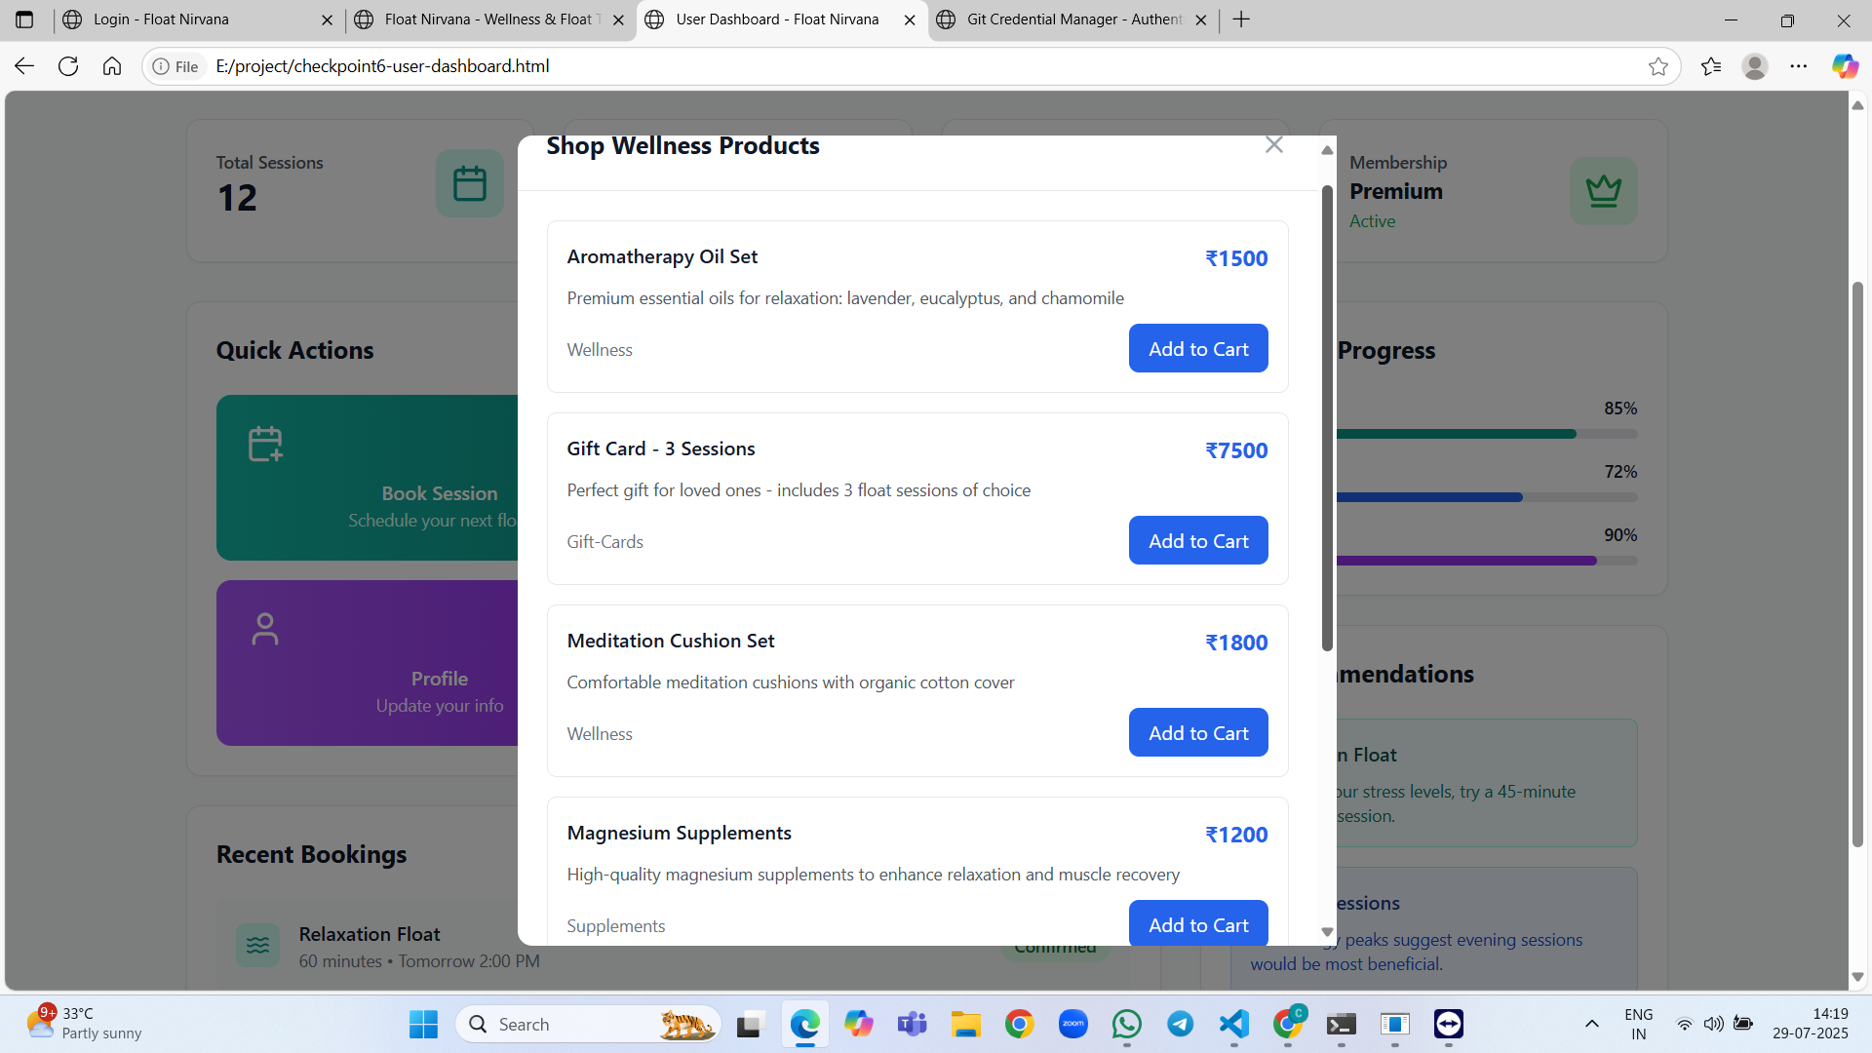
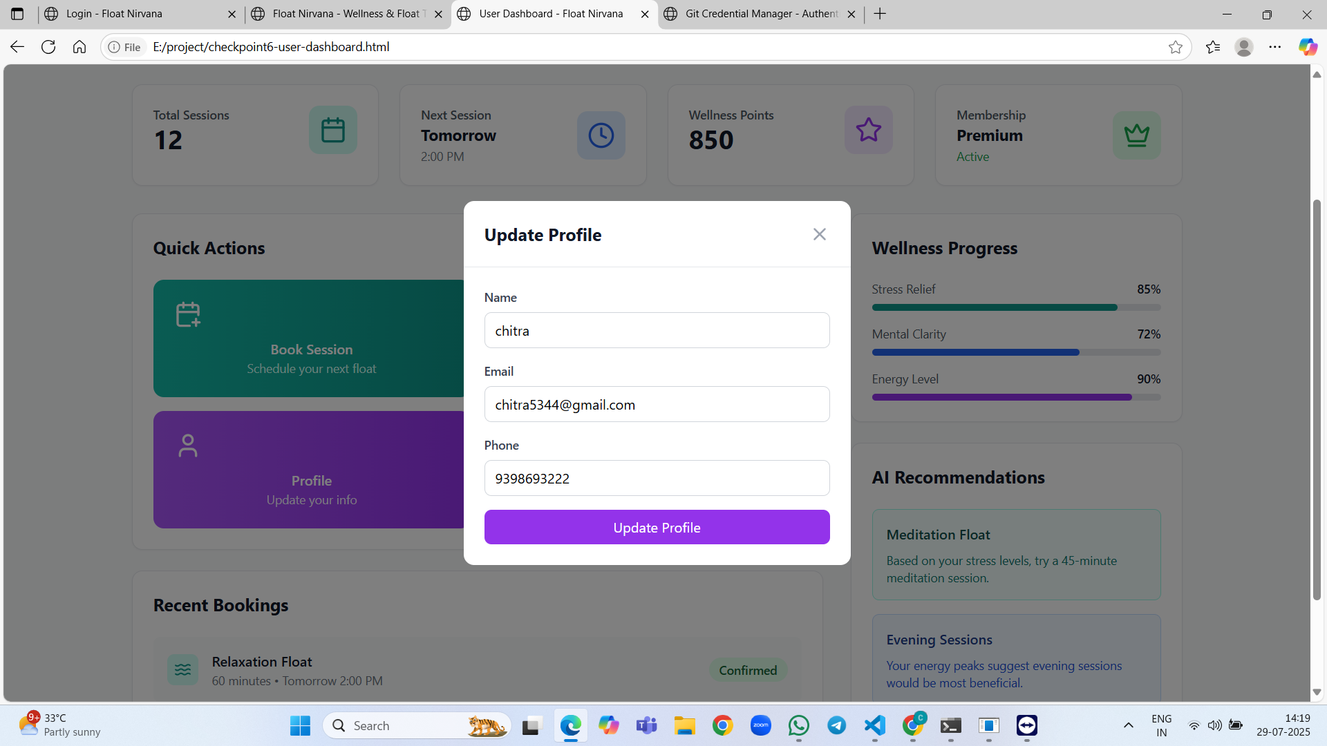

Slide 23
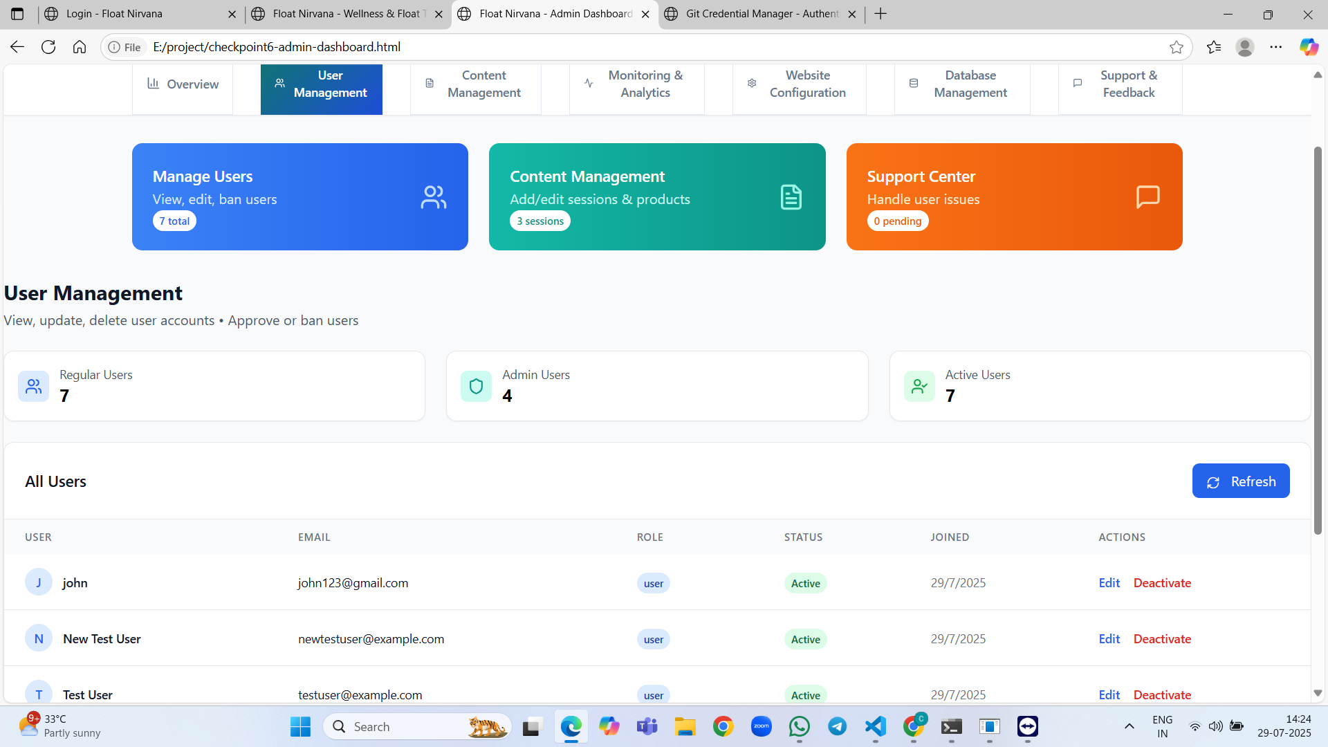
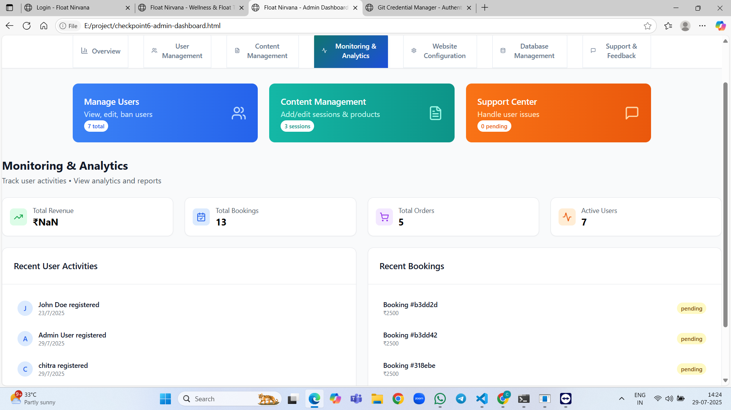
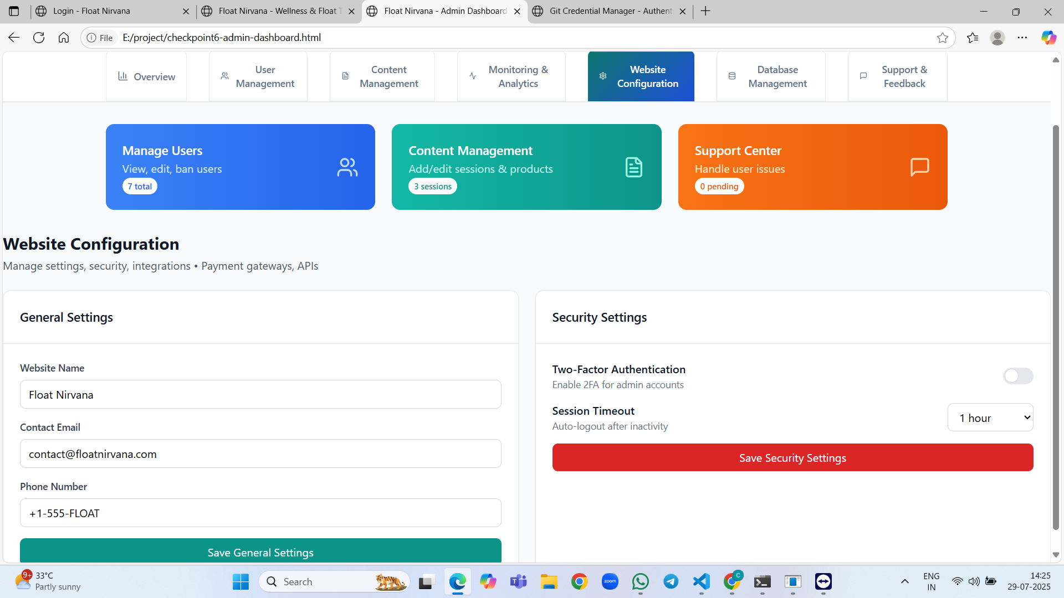
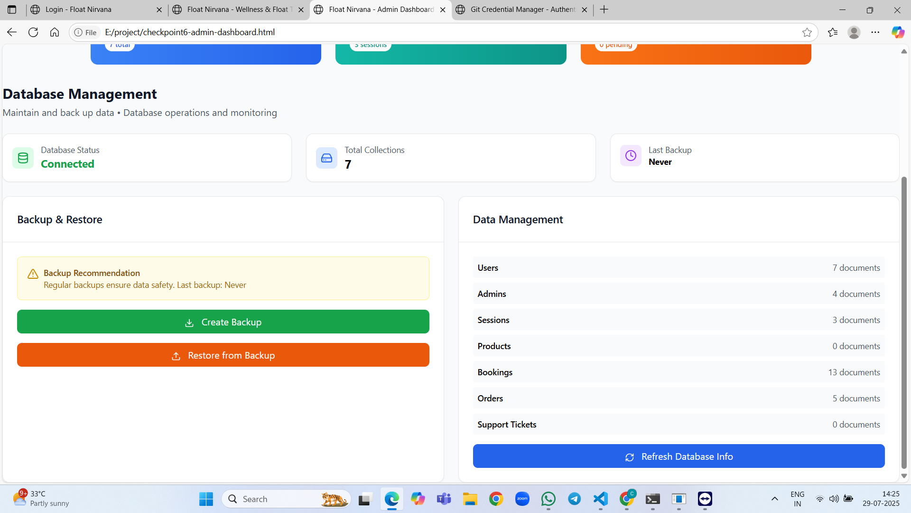

Slide 24
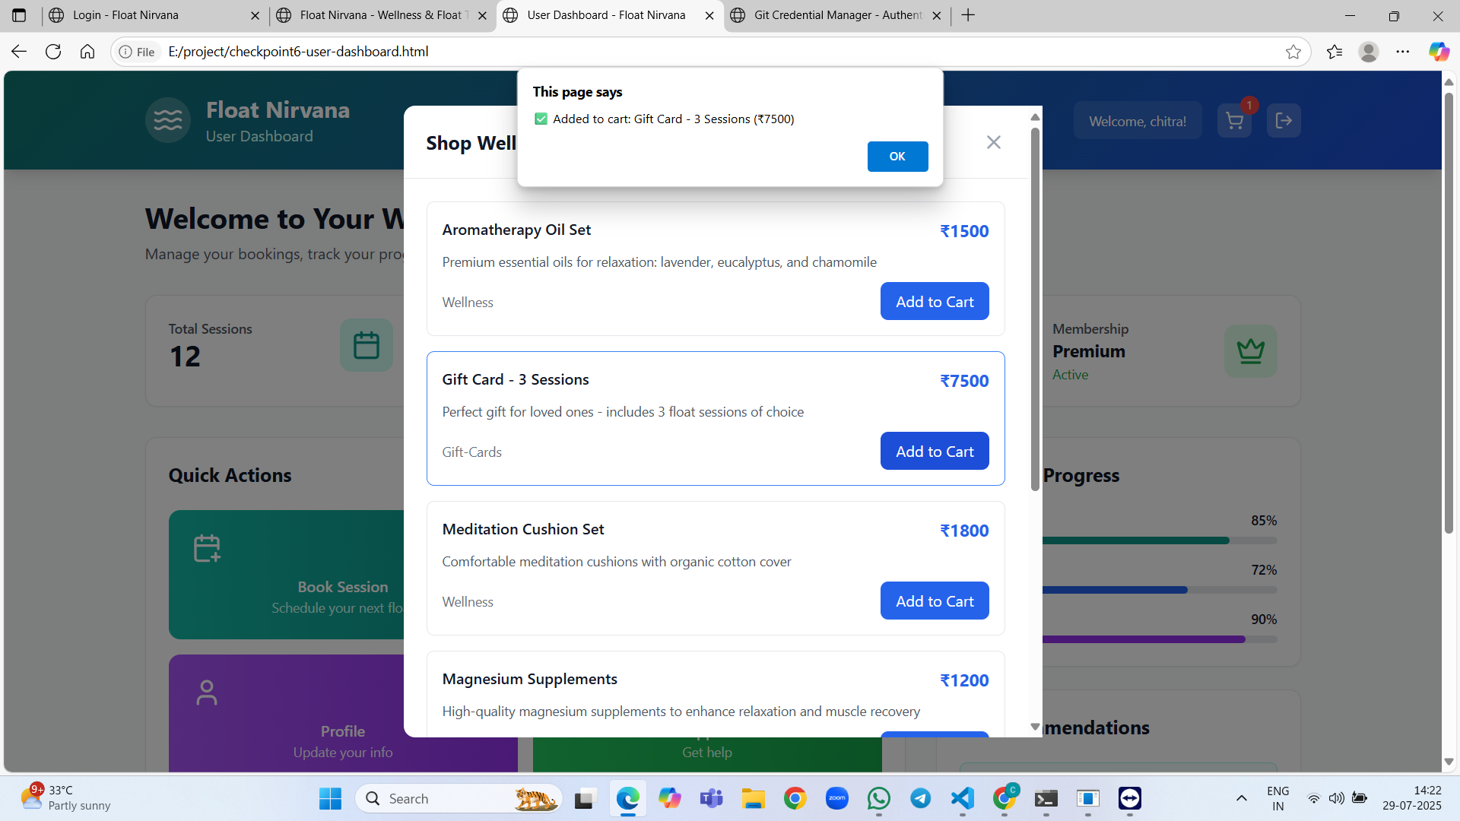
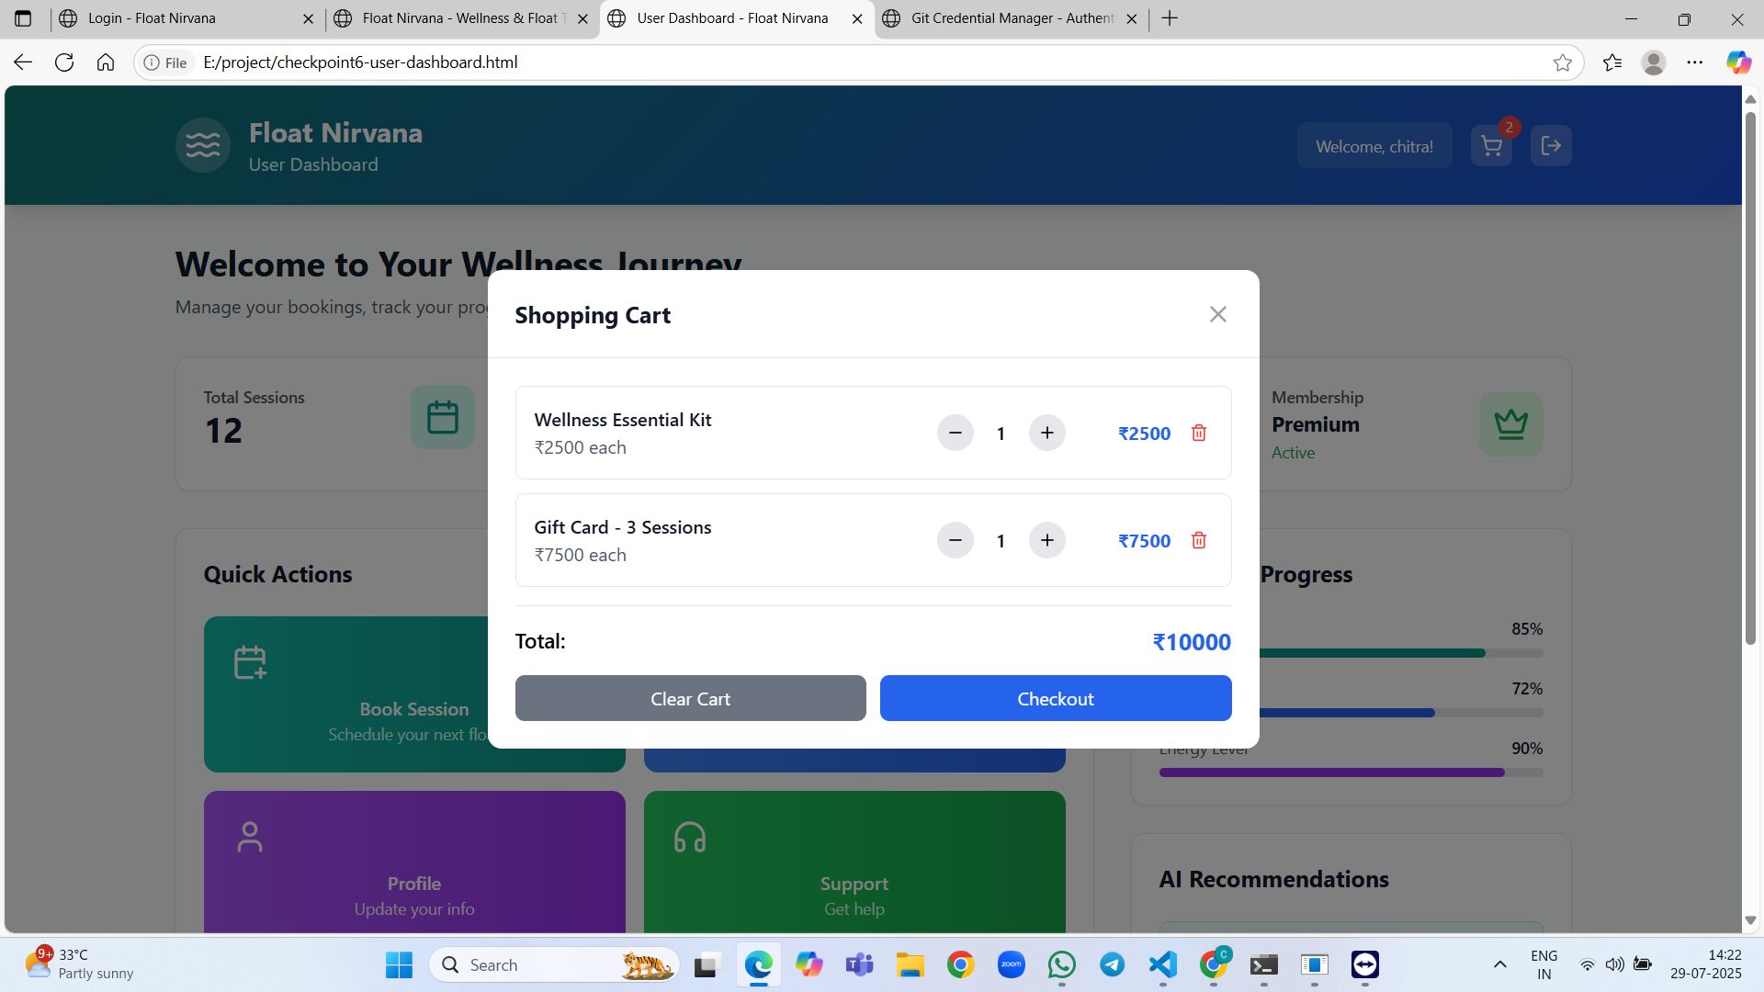
GitHub Repository : https://github.com/kolli-chitra123/float-nirvana.git

Slide 25
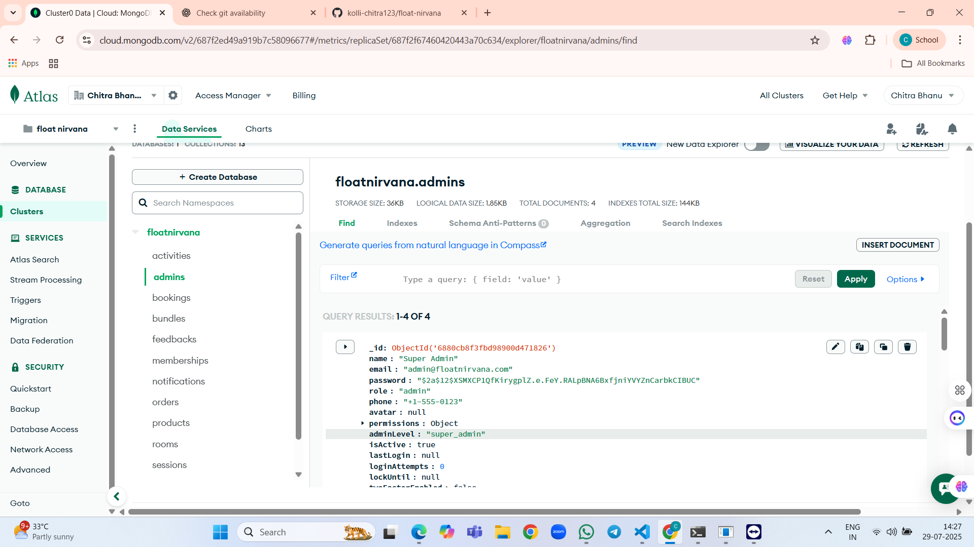
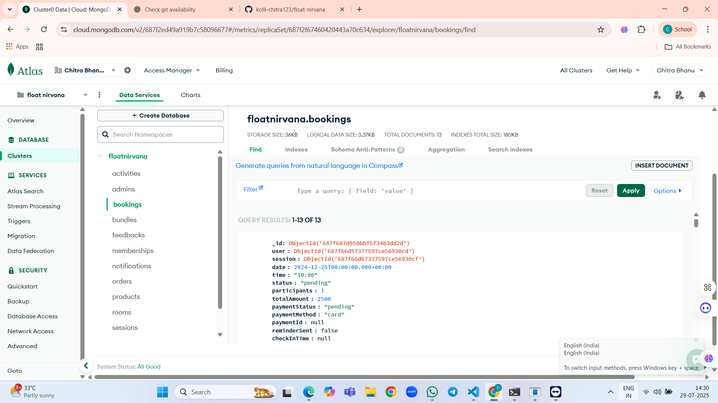
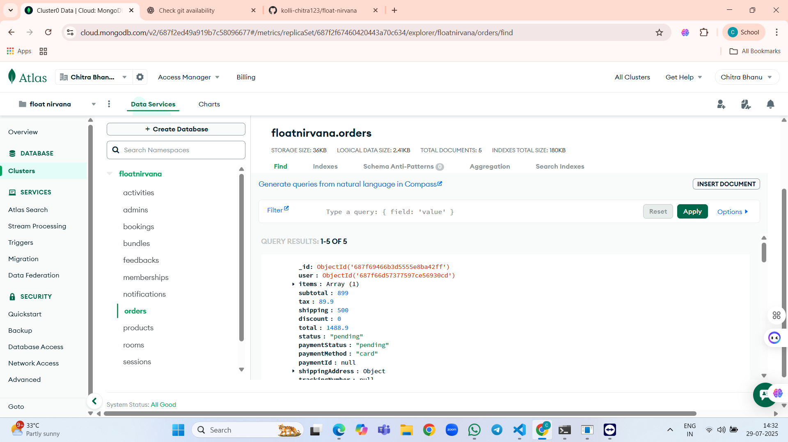
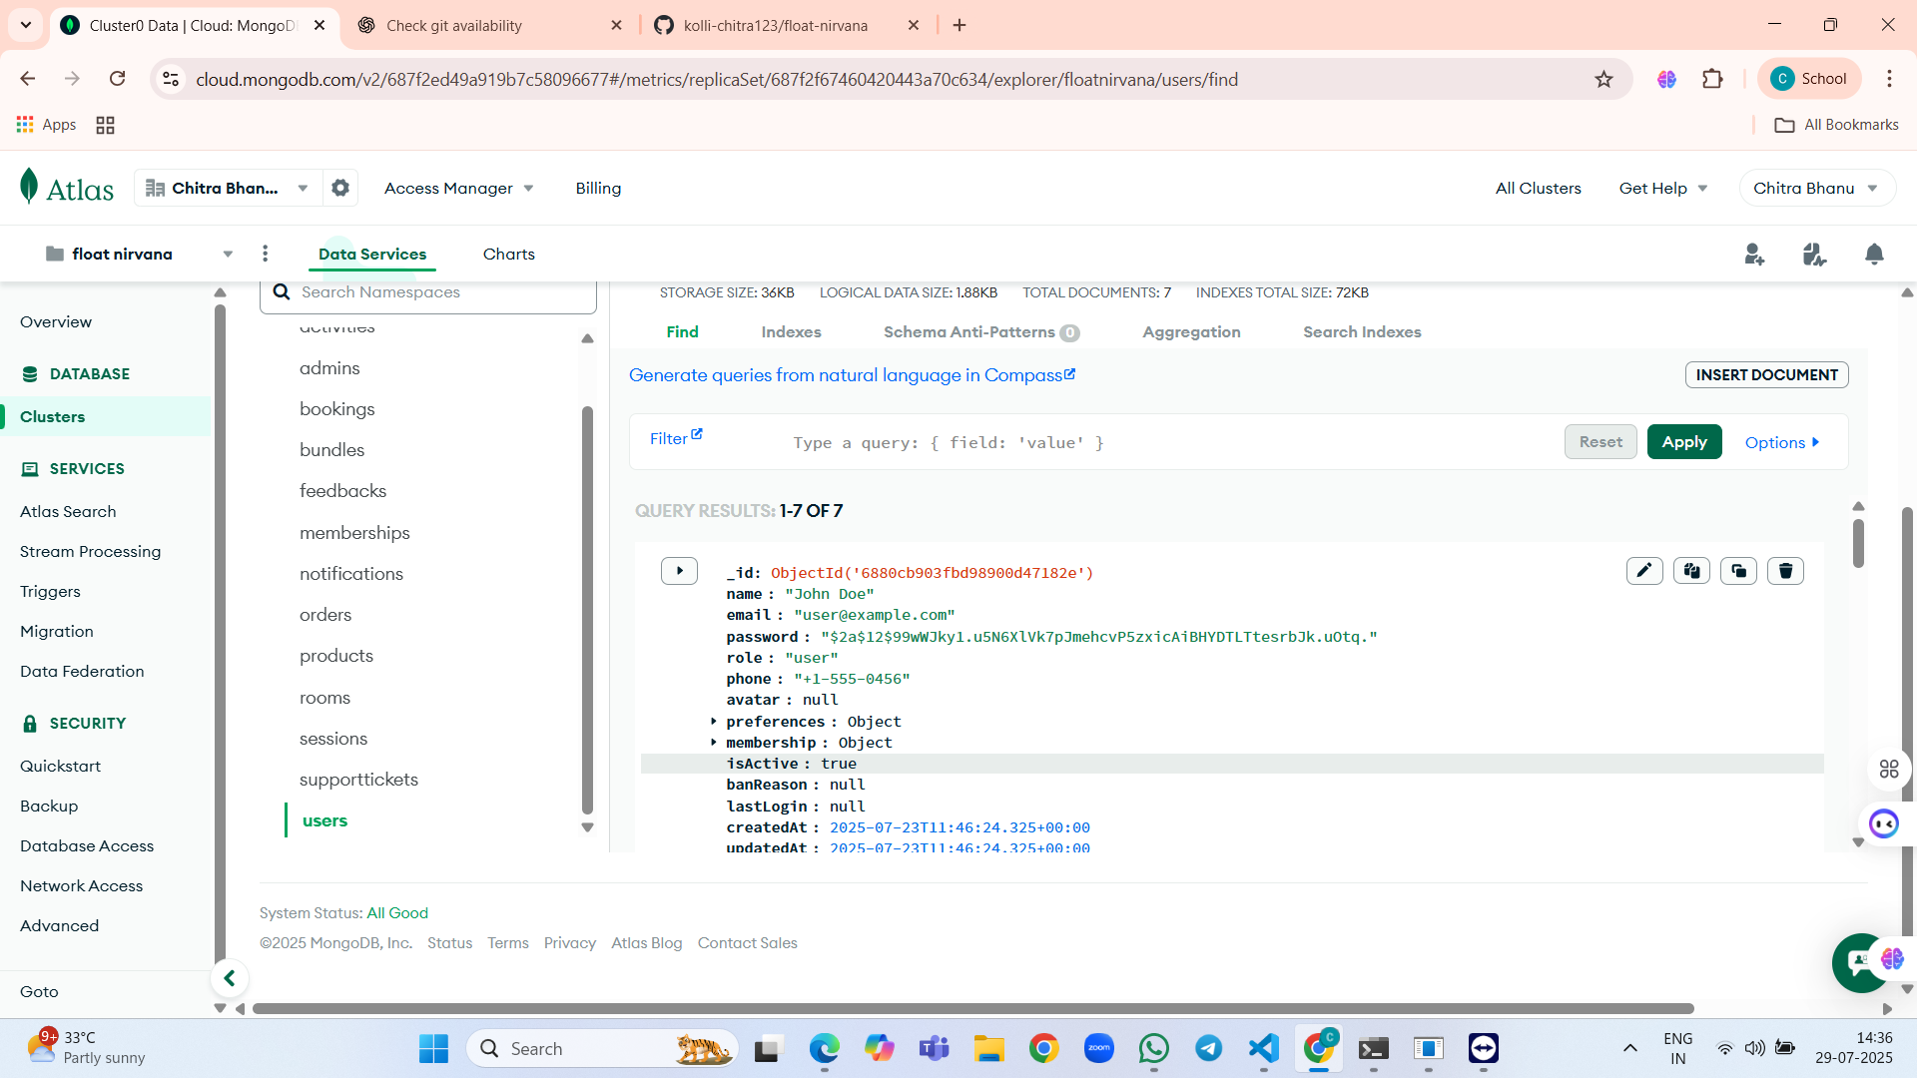
Database Screenshots: Mongodb Atlas

Slide 26
Conclusion
The main objective of the Float Nirvana project was to create a comprehensive, user-friendly web platform that addresses the fragmented access to float therapy and wellness services, streamlines booking and management for both users and providers, and offers advanced tools for administrators. The final application successfully meets these goals by providing a robust system that integrates session bookings, user authentication, a product marketplace, real-time notifications, support ticket management, and an admin dashboard with analytics—all powered by a modern full-stack architecture using React, Node.js/Express, and MongoDB.
During development, several significant challenges arose, including ensuring real-time responsiveness of the booking system, maintaining rigorous security for user authentication and data privacy, and designing an intuitive yet powerful admin dashboard for business users. These were addressed by leveraging Socket.io for instant updates, implementing JWT-based authentication and role-based permissions, and adopting an iterative development process that incorporated continuous user feedback to refine the interface and workflows.
Despite its strengths, the current system has some limitations. Full integration with a payment provider (such as Stripe) remains to be implemented, and the platform’s scalability for very high concurrent usage has not been tested in production. Future enhancements could include support for additional wellness modalities, expanded API integrations, mobile app interfaces, and more granular analytics. Nonetheless, Float Nirvana provides a strong foundation for accessible, modern wellness management and positions itself as a significant improvement over traditional, fragmented service models.

Slide 27
Future scope
Mobile Application Development: Building dedicated mobile apps for iOS and Android would offer users the convenience of booking and managing float therapy sessions on-the-go, enable push notifications, and support device-native features like biometric authentication or calendar integration.
Advanced Payment Integration: Fully implementing secure and seamless payment gateways (such as Stripe, Razorpay, or PayPal) would allow immediate in-app purchases for bookings, products, and memberships, enhancing monetization and operational efficiency.
AI-Powered Recommendations: Integrating machine learning algorithms could enable personalized session recommendations, targeted wellness content, or predictive scheduling based on user preferences, health goals, and historical data.
Expanded Wellness Services: Extending the platform to include additional wellness modalities (e.g., yoga, meditation workshops, massage therapy) and enabling cross-service bookings would position the app as a broader holistic wellness ecosystem.
Enhanced Real-Time Features: Leveraging real-time communication further for features like live chat support, instant promotions, and group booking synchronization would improve user engagement and support quality.

Slide 28
Scalability and Performance Improvements: Migrating to cloud-native infrastructure (like containerization and auto-scaling), implementing content delivery networks (CDNs), and optimizing database architectures would ensure smooth operation as user volume grows.
User and Business Analytics: Providing deeper analytics for both clients (e.g., progress tracking, wellness insights) and administrators (e.g., advanced business intelligence dashboards) could help tailor offerings and improve service outcomes.
Integration with Wearables and Health Apps: Connecting with health platforms (e.g., Apple Health, Google Fit, Fitbit) could allow users to synchronize wellness data, automate progress tracking, and receive tailored recommendations.
Multilingual and Accessibility Support: Adding full multi-language capability and advanced accessibility features (WCAG compliance, voice control) would make the platform inclusive for a global community.
Community and Social Features: Implementing user communities, forums, event management, and referral systems would foster social engagement and organic growth.
These enhancements would greatly expand the reach, utility, and impact of the Float Nirvana platform, positioning it as a leading solution in the evolving digital wellness market.

Slide 29
References
Feinstein, J. et al. “Examining the Short-Term Anxiolytic and Antidepressant Effect of Floatation-REST.” PLoS ONE, 2018. – A foundational research study into the clinical benefits of floatation (sensory deprivation) therapy, supporting the core wellness use case of the application.
React Official Documentation – Comprehensive guide to building modern user interfaces with React, instrumental in creating the frontend of the platform.
Node.js Documentation and Express.js Guide – Essential resources for designing and implementing the backend API and server-side logic.
MongoDB Atlas Documentation – Detailed documentation on deploying, modeling, and managing a cloud-hosted NoSQL database for application data.
Socket.IO Handbook – Official handbook for adding real-time features (such as notifications and support ticket updates) to the application.

Slide 30
THANK YOU

